Slide 1
Research Paper Review & Parallel Strategy Proposal

Slide 2
Group Members:
• Alishba Naveed – 22i-0808 • Saffi Muhammad Hashir – 22i-1293
• Hamza Ahmed – 22i-1339
Research Paper
Title: A Community Detection-Based Parallel Algorithm for Quantum Circuit Simulation Using Tensor Networks
Authors: Alfred M. Pastor, Jose M. Badia, Maribel Castillo Published: January 2025 (Springer)

Slide 3
Why This Problem Matters
Simulating large quantum circuits on classical machines is challenging due to: – High memory usage – Exponential time complexity
Efficient parallel and memory-aware simulation strategies are required.

Slide 4
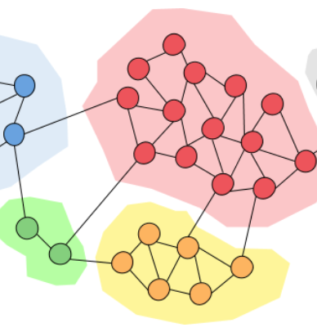
What is ComPAr?
ComPar = Community-based Parallel Contraction Algorithm
• Treat tensor network as a graph • Apply community detection • Contract communities in parallel • Final contraction executed on GPU

Slide 5
Community Detection (Girvan–Newman)
Techniques for connecting
• Graph-based partitioning algorithm • Detects weakly connected clusters (communities) • Enables independent contraction of sub-networks in parallel

Slide 6
ComPar Execution Pipeline
Circuit → Tensor Network
Tensor Network → Community Detection
Community Contraction (CPU, Parallel)
Final Global Contraction (GPU)

Slide 7
Benchmarking Results
Tested on Circuits: • QFT (Quantum Fourier Transform) • RQC (Random Quantum Circuits) • GHZ (Greenberger–Horne–Zeilinger)
Performance: • Outperforms GN_gpu & ParSli • Simulates up to 144 qubits

Slide 8
Our Parallel Strategy
Technologies Used:
• MPI – Community-wise distribution • OpenMP – Intra-community contraction • OpenCL (Optional) – Final contraction on GPU • METIS – Alternate partitioning strategy

Slide 9
Technology Usage Breakdown
1-MPI – Message Passing Interface • Why: Distributed memory parallelism • Where: Each MPI process contracts one or more communities
2-OpenMP – Thread-Level Parallelism • Why: Parallel contraction within a community • Where: Multithreaded tensor contractions inside MPI processes
3-OpenCL – GPU Acceleration (Optional) • Why: Speed up the final contraction • Where: Final tensor contraction after all communities are reduced
4-METIS – Graph Partitioning Library • Why: Course requirement and performance comparison • Where: Alternate to Girvan–Newman for graph partitioning

Slide 10
GN vs METIS – Partitioning Strategy
We will compare both partitioning approaches: • Girvan–Newman (used in the paper) • METIS (used for coursework)
Metrics for Comparison: • Number of edge cuts • Contraction execution time • Overall speedup and efficiency

Slide 11

Tools & Libraries
Tool/Library | Purpose
MPI | Process-level parallelism
OpenMP | Thread-level parallelism
METIS | Graph partitioning
NetworkX | GN community detection
QXTools (Julia) | Tensor operations & contractions
Python/Julia | Preprocessing, orchestration, visualization

Slide 12
Benchmarking Results
• Implement and evaluate ComPar with dual partitioning strategies • Apply hybrid parallelism using MPI + OpenMP • Explore GPU acceleration using OpenCL • Fulfill course requirements and extend the research work

Slide 13
THANK YOU

